Slide 1


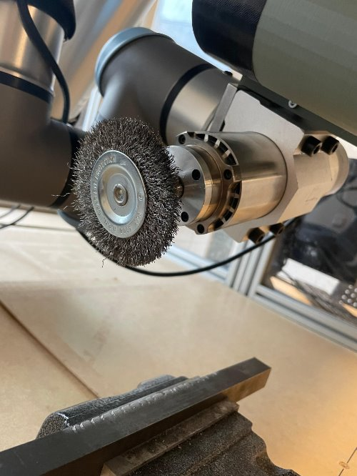
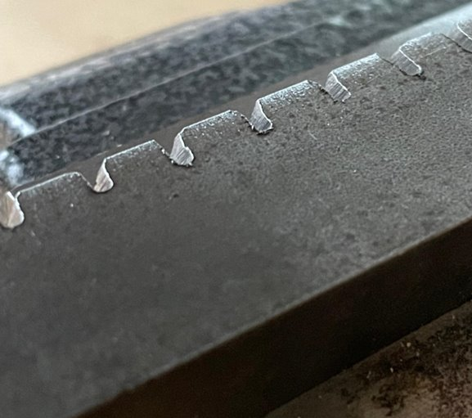
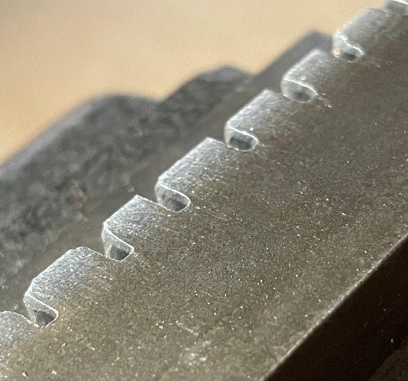
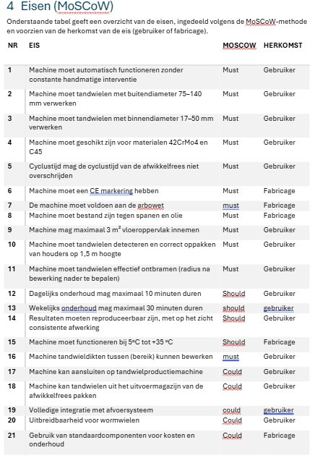
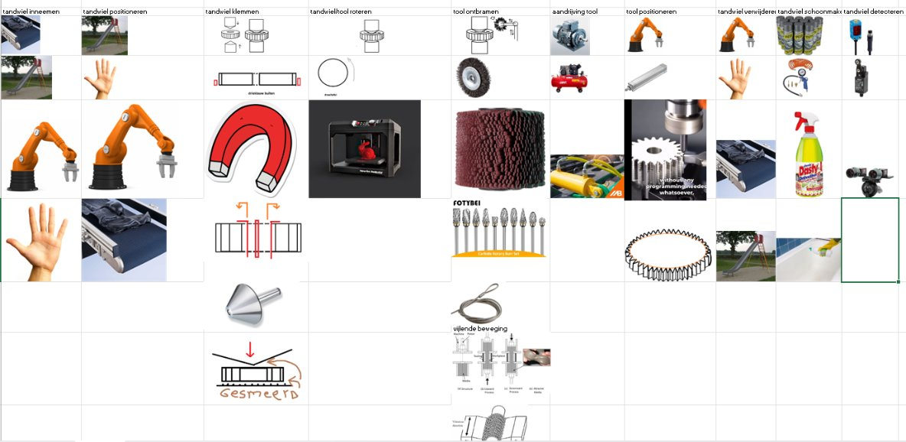
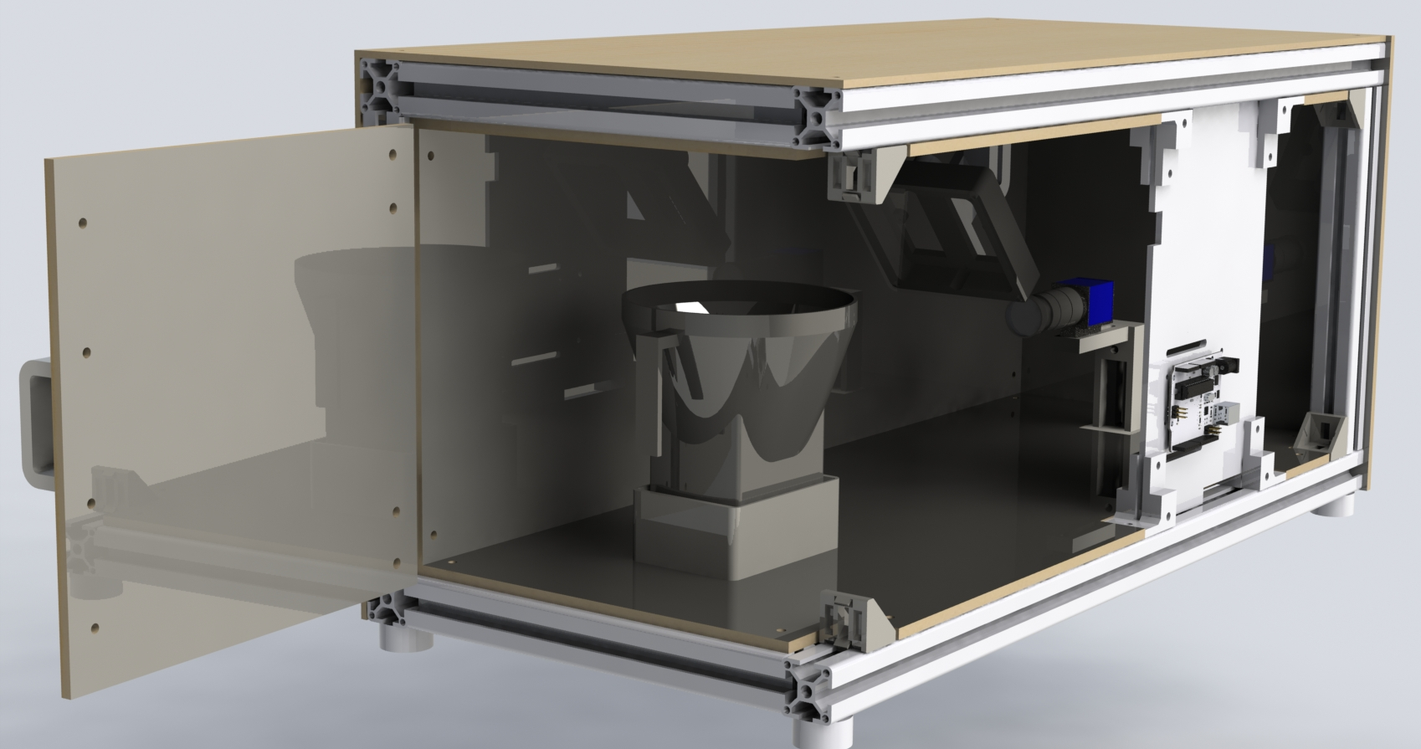
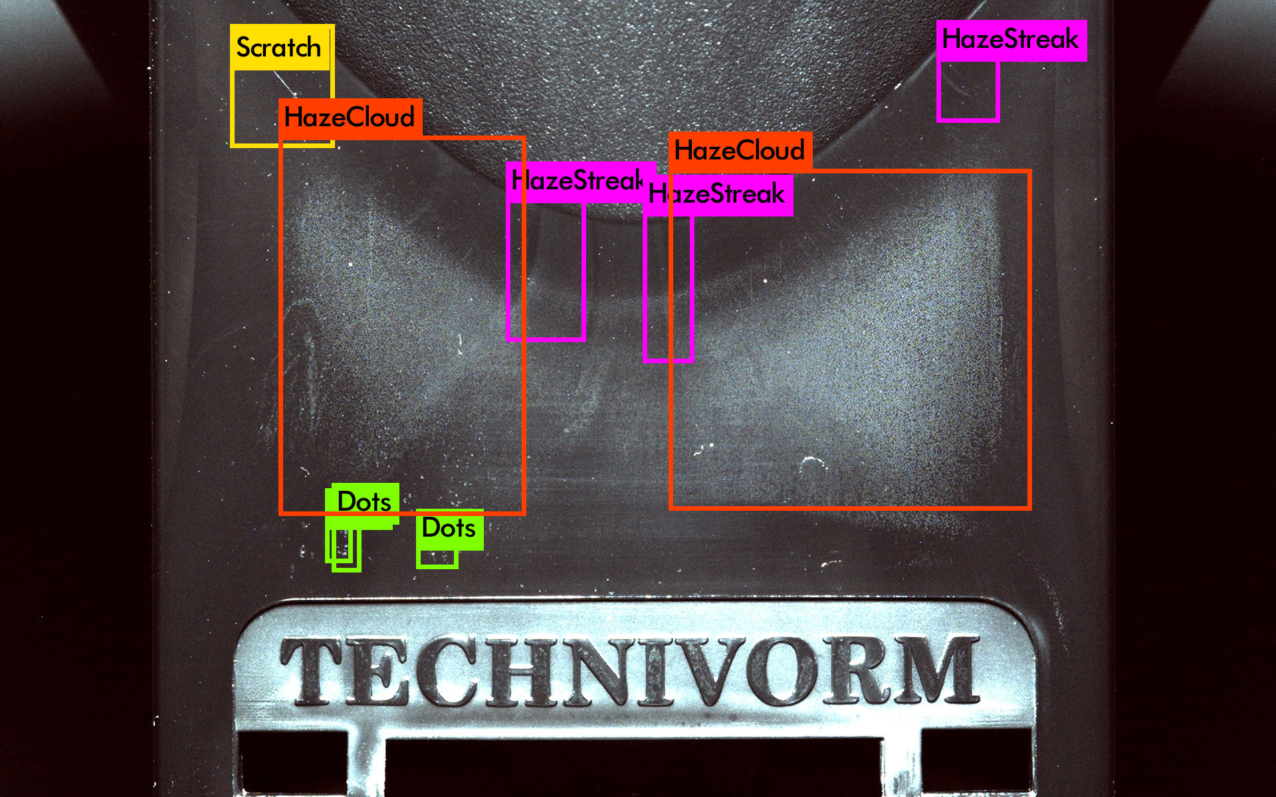
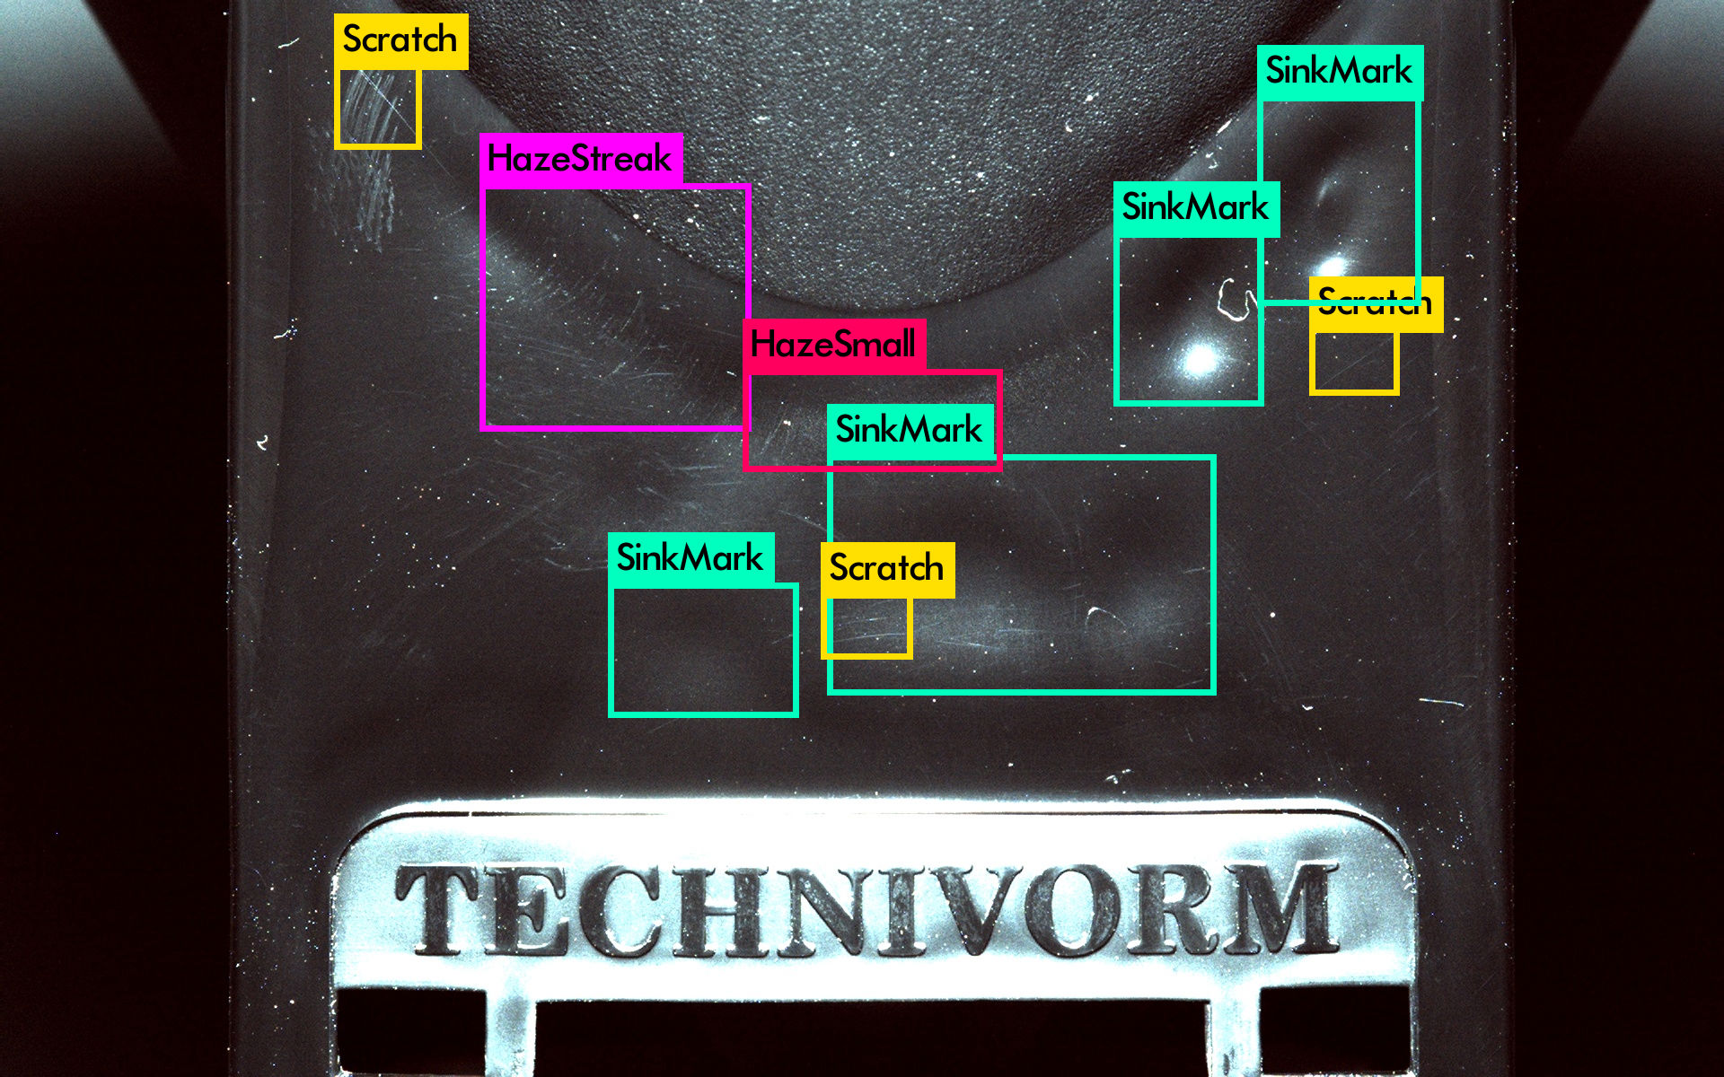
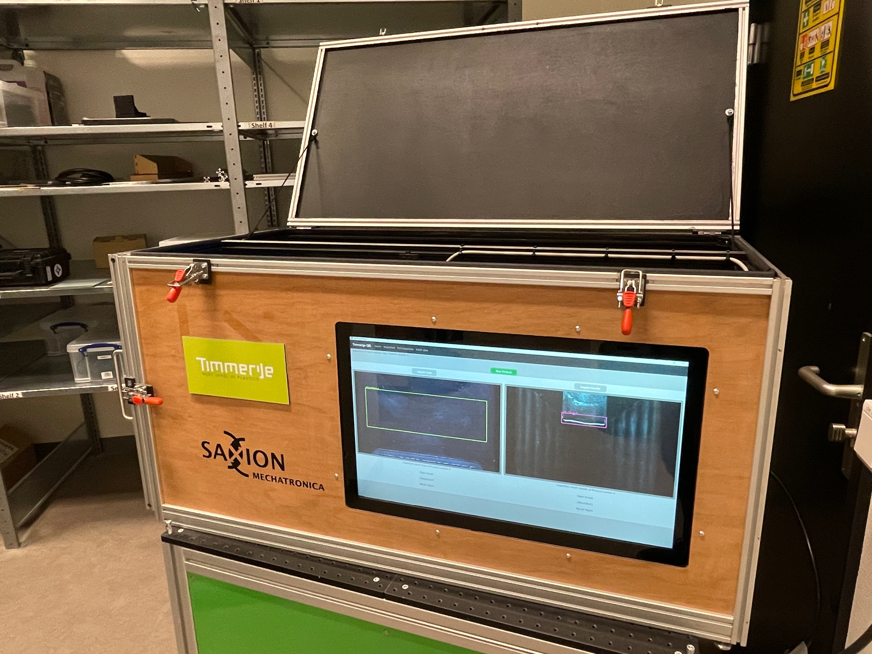
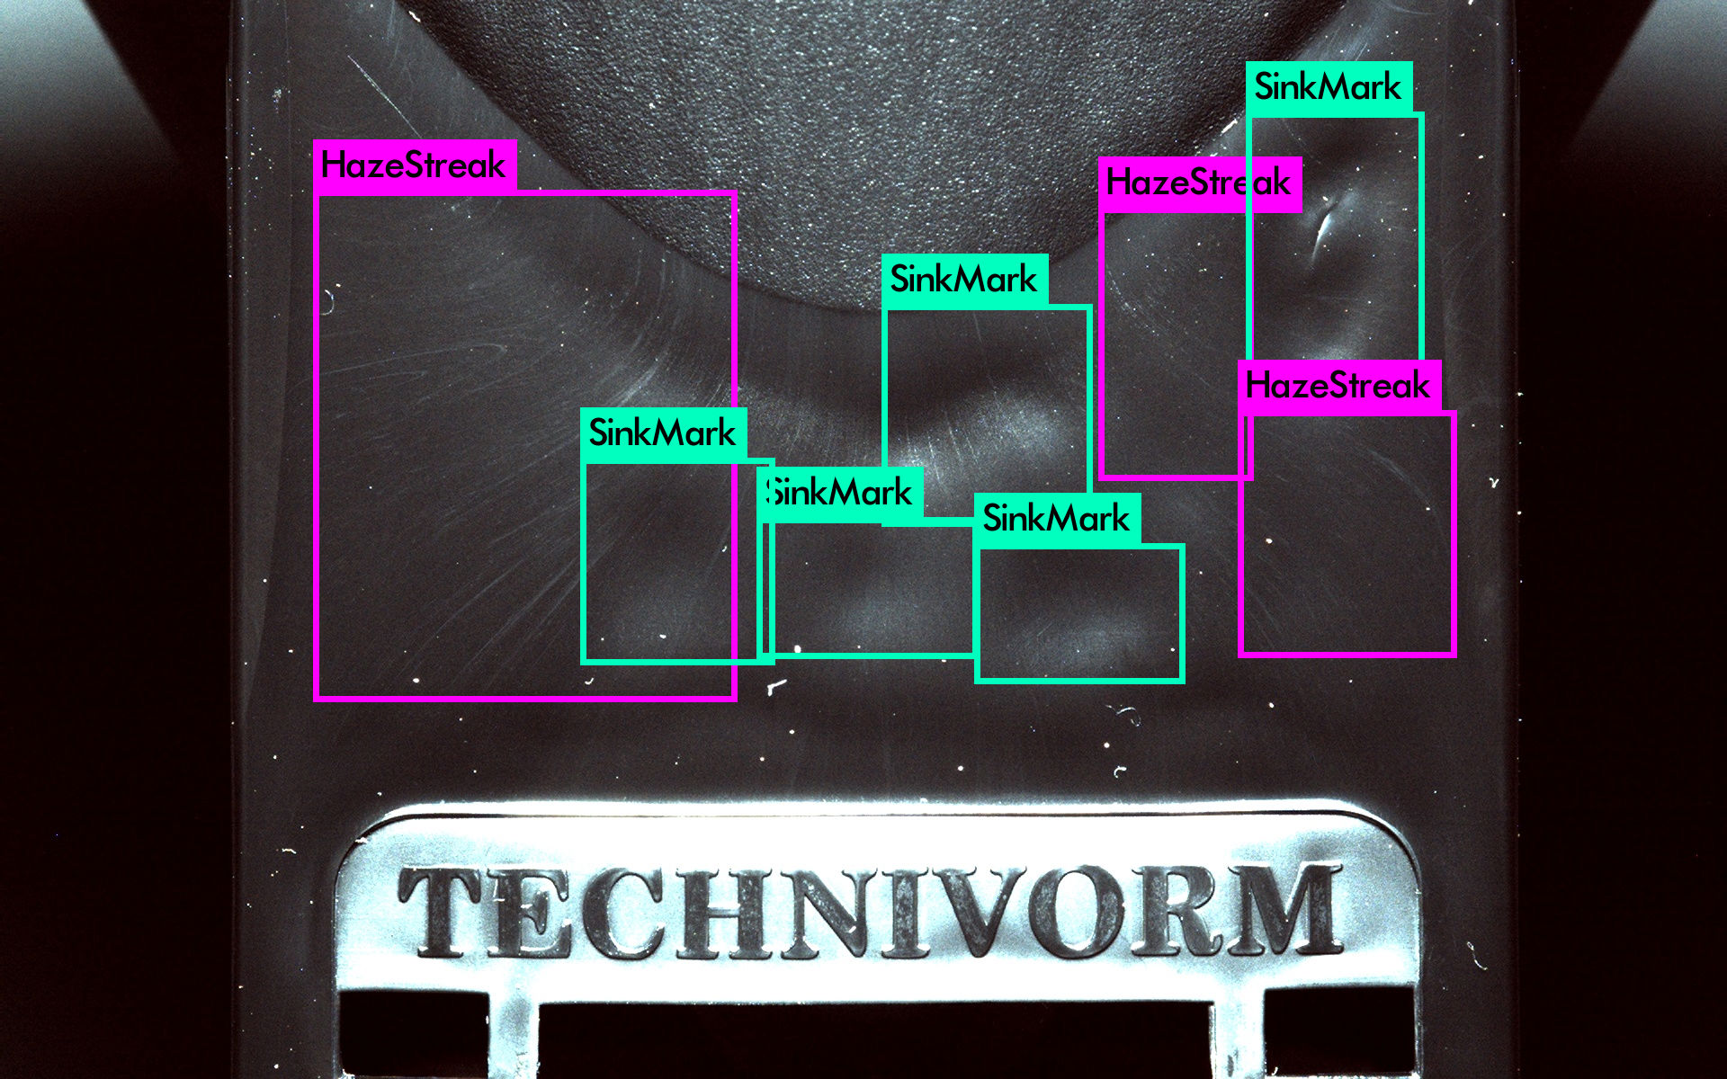
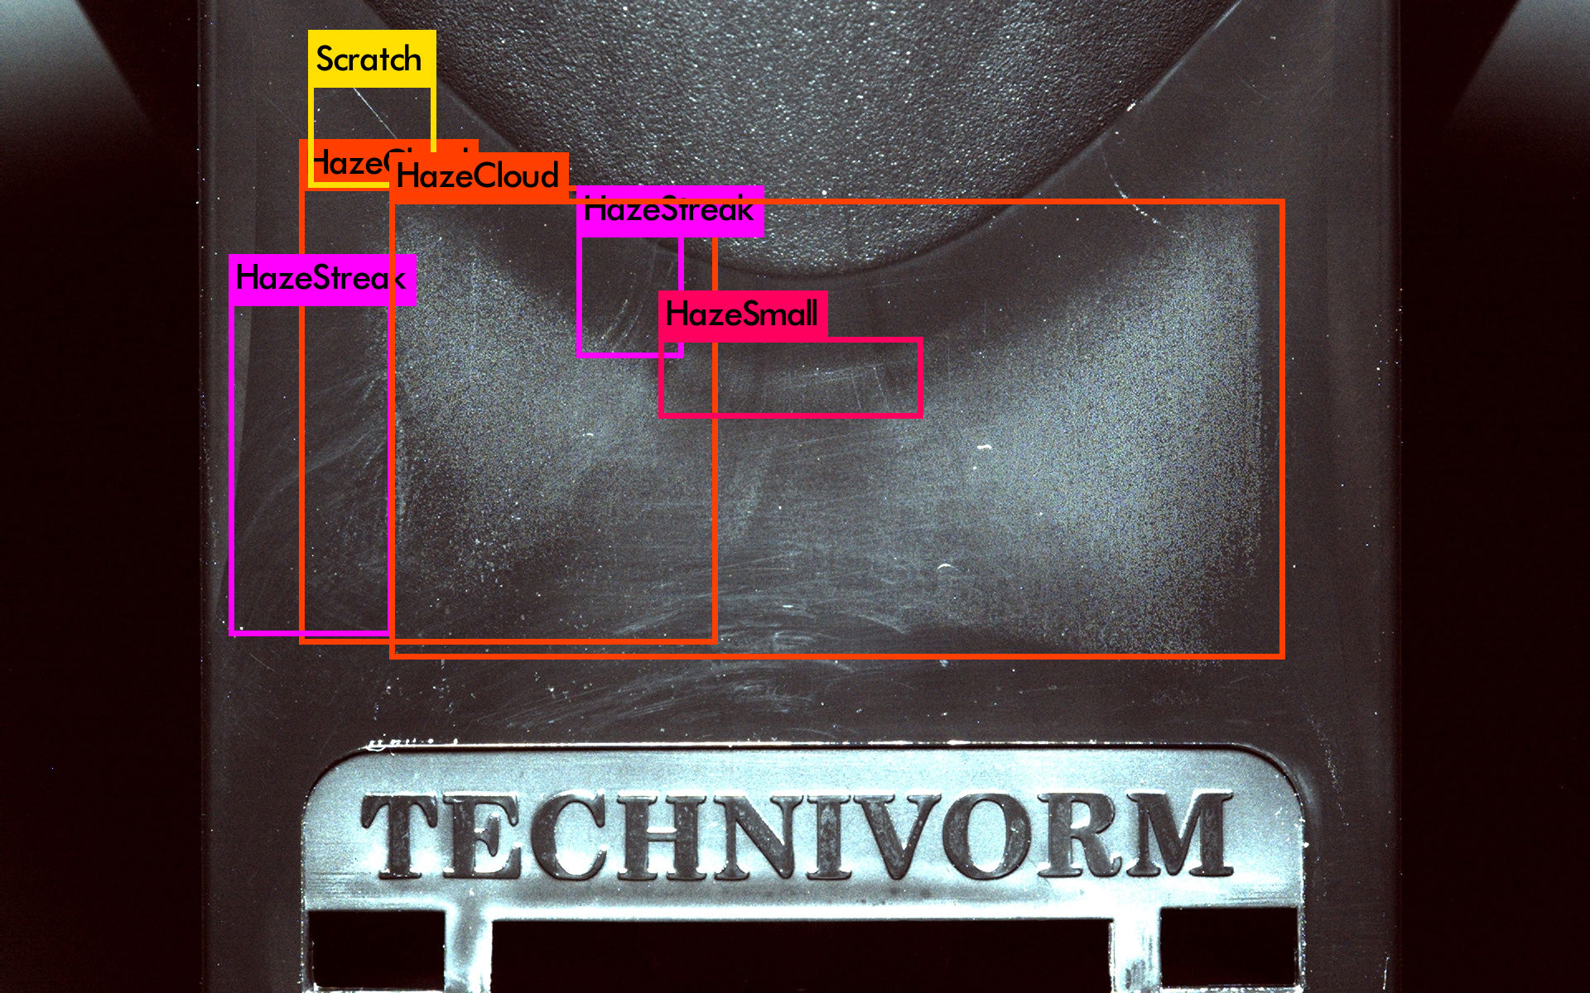
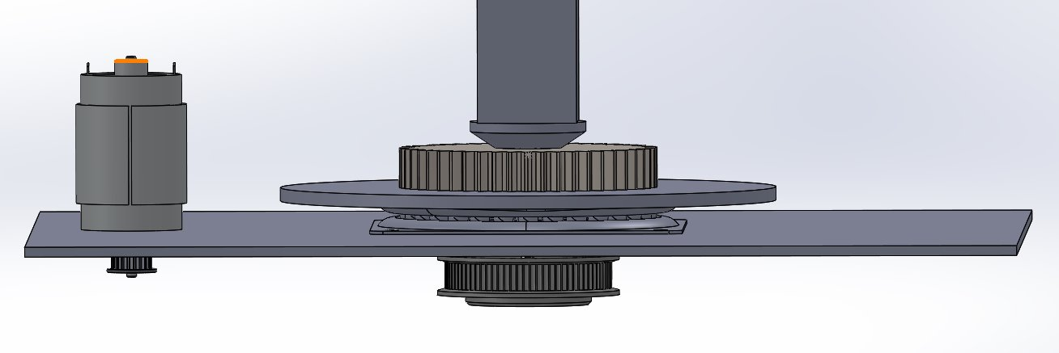
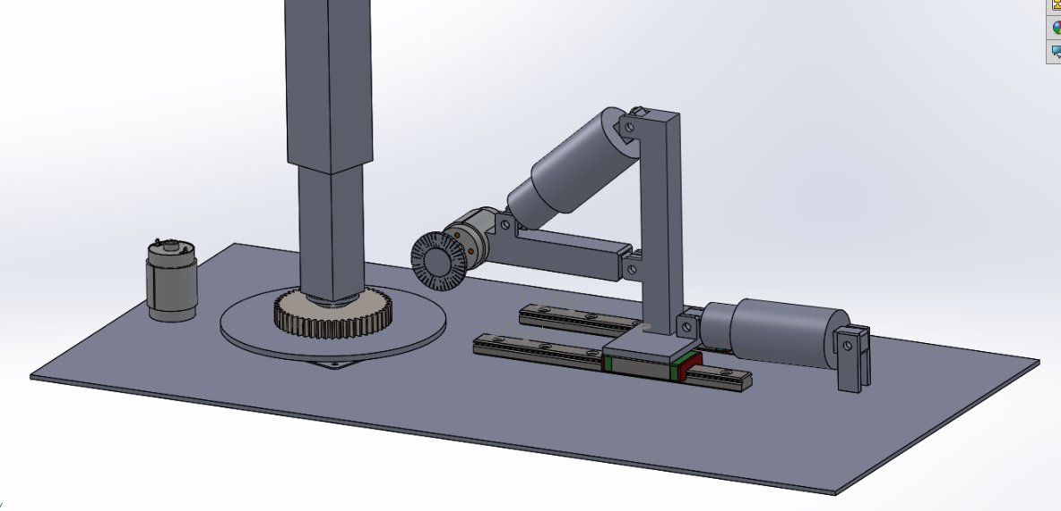
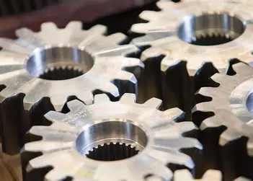
[Gear deburring]
Student team: Sven Kerkhof, Cedric Aerentz en Gijs Winkelhorst
Supervisors: Joris Spikker
Research problem and objectives
Key results and achievements (2/2)
Huima drive solutions constructs (amongst others) gearboxes for the watering/heating system in greenhouses. After plants have been watered, they should quickly be dried, or mold will form. To do this, a lamp should be hanged just above the plant. When the plant grows, this lamp has to move.
Gears for this mechanism are made in the huima factory, and when the teeth are cut, they leave a sharp ridge on 1 of the round faces of the gear, a so-called burr. When the gears are assembled, this means that they dont fit snug against one another. Also, these burrs could contaminate the lubricating oil, shortening the lifespan.
problem statement: the burrs have to be removed without damaging the gears in a meaningful way.
context: gears of many different sizes and materials should be deburred. Currently, this is done manually using sandpaper and brushes. This is however rather time-consuming and not precise. It also requires a significant amount of force from the worker.
Current automated solutions are either not flexible enough for the variety of gears, or are very expensive/maintenance intensive.
significance: this step is needed to make lasting, quality gearboxes. Automating this process decreases costs, increases employee hapiness, and could speed up the process.
research question(s): how could one automate the process of gear deburring?
After we had made a preliminary selection, it was time to see whether our idea would actually produce the desired result. Our idea was to remove the burrs using a wire brush. We attached a wire brush to a robot and carried out a test.
We took a piece of steel from the workshop and created a number of burrs similar to those on the gears. We clamped this piece of steel under a robot with a steel brush head and then carried out several tests to see if the burrs had actually disappeared.
Robot with steel brush
Burr before
Burr after
Methodology and approach
Conclusions and recommendations
In this project, we are using a structured approach to arrive at a solution step by step. To this end, we first drew up a program of requirements and a function diagram. We also created a morphological overview to list all the partial solutions.
What can we conclude from your research? What do you recommend for practical application or continuation of your research? [template guidance] – explain:
key insights gained from the research, how results address the problem
significance of your contributions and broader implications for the field
implementation guidelines and conditions for optimal application
best practices identified and considerations for industrial adoption
Supporting visualisations or data to show results, e.g. charts, graphs, images, prototypes to support the conlcusions and recommendations. :
Key results and achievements (1/2)
Our morphological overview has shown that a concept using a wire brush is the most suitable solution for deburring the gears. This is simply because all other possible solutions are not feasible within the scope of the assignment. De Huima wants to be able to deburr many different types of gears with varying diameters and heights, so our solution must be very dynamic. Gears can also be very small in combination with many teeth, which means that deburring with a milling cutter, for example, is not possible. We now use a turntable that allows us to rotate the gear wheel and a wire brush that can be adjusted to the height and diameter of the gear wheel by means of two cylinders.
Discussion starters
For a follow-up study, another deburring solution could be explored. Perhaps something could even be adjusted in the gear manufacturing process to prevent burrs from forming.
More information can be found on our website:
Acknowledgements
https://www.saxion.nl/onderzoek/lectoraten/smart-mechatronics-and-robotics
A special thanks to the people of Huima, Mr Spikker, Mr koiter, Mr de Bruijn.

